Slide 1

5 Keys to Creating a Disaster Recovery Plan for SMBs
2017
Strategic Support Solutions
https://www.strategicsupport.com

Slide 2

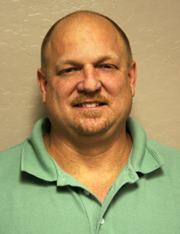
Today’s Presenters
Eric Bornfriend
Marketing Director
Jeff Korte
Sales & Technical Support Manager

Slide 3
How do you define a DISASTER?

Slide 4

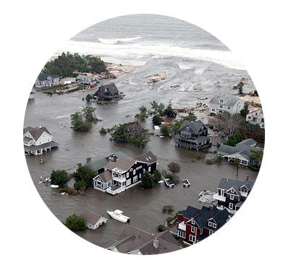
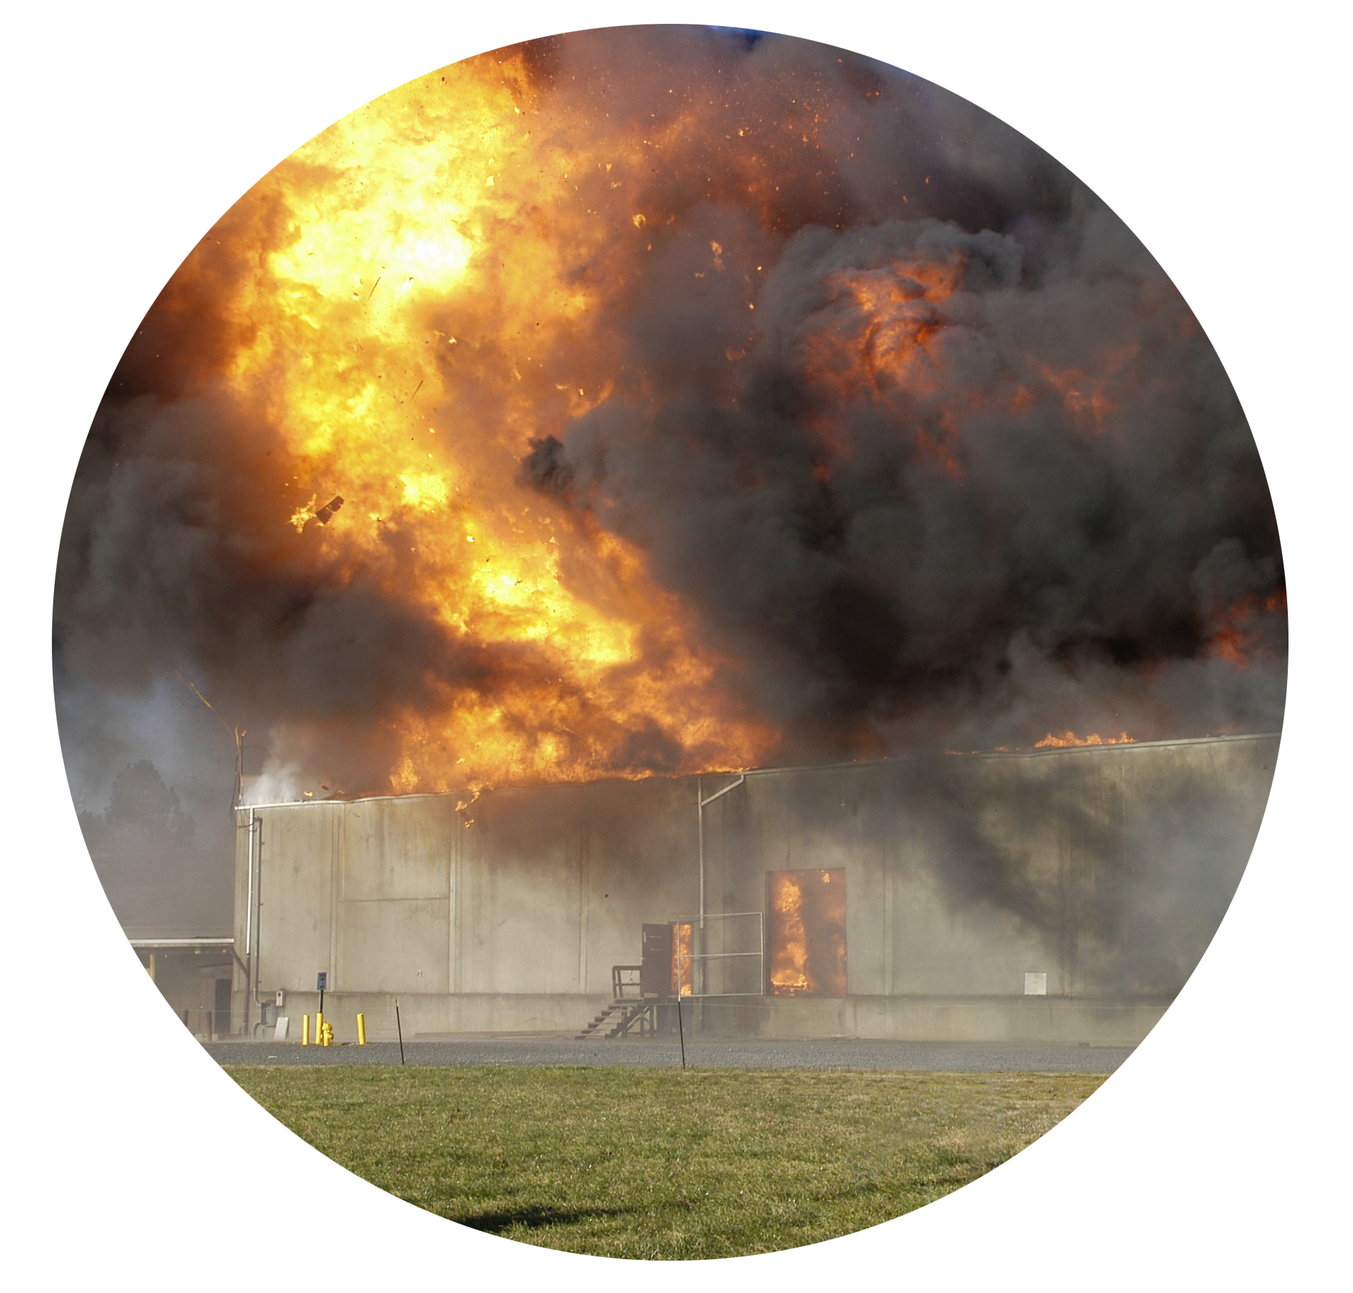

Are these on your list?
Ransomware
Hurricanes
Floods
Power outages
Tornadoes
Fires
Cryptolockers
Mechanical failure

Slide 5
What is your “Readiness IQ”?
Question 1.
In any given year, how many businesses will experience a disruption lasting more than a day?
Answer:
About one-third of small and mid-sized businesses will experience a disruption to their operations lasting 24 hours or more. When the National Federation of Independent Business surveyed its members, 30% reported that in the past year, they had experienced a disruption to their operations lasting at least 24 hours. The disruptions arose from a range of causes, such as storms, power outages and the like.

Slide 6
What is your “Readiness IQ”?
Question 2.
How many businesses will not re-open following a disaster?
Answer:
According to the U.S. Federal Emergency Management Administration (FEMA), 43% of businesses will not re-open following a major disaster. This alarming figure does not take into consideration the consequences of disasters that were not designated “major” disasters by the federal government, such as fires and power outages, which can be devastating to small and mid-sized businesses.

Slide 7
What is your “Readiness IQ”?
Question 3.
If you cannot get your business back online within 5 days of a disruption, what are the odds that your business will survive?
Answer:
About 10%. A survey of small businesses in the immediate vicinity of the World Trade Center at the time of the 1993 bombing found that of those businesses that could not resume their operations within five days, 90% were out of business a year later.

Slide 8
What is your “Readiness IQ”?
Question 4.
How many businesses worry about the loss of unrecoverable stored data and information?
Answer:
50% worry a “great deal” about the risks of losing stored data and not being able to recover it, according to the 2015 Travelers Business Risk Index.

Slide 9

What is your “Readiness IQ”?
Question 5.
How many businesses have a written business continuity plan?
Answer:
Only 50%, according to the 2015 Traveler Business Risk Index which surveyed 1200 businesses to gather this information.

Slide 10
What is your “Readiness IQ”?
Question 6.
What are the most common reasons that small and medium-sized businesses fail to take measures for business continuity planning?
Answer:
Lack of knowledge, lack of time and lack of resources are the three top reasons cited by small and medium sized business owners to explain why they don’t have business continuity plans. This information was gathered in surveys conducted by local chapters of the American Red Cross.

Slide 11

What is your “Readiness IQ”?
Question 7.
How many work-hours does the typical small business lose each year when IT systems fail and employees cannot access their files?
Answer:
According to information published in “IT Pulse”, 552 employee work-hours are lost annually, that is more than one-quarter of the year for a single employee of a typical small business!

Slide 12
What is your “Readiness IQ”?
Question 8.
What is the average cost of hourly downtime when employees cannot access their computer data?
Answer:
Survey results show that a small business that has an hour of “down time” will lose, on average, $20,000 due to the disruption. But if the disruption extends to three hours and employees cannot get back online and resume work, that hourly loss rises to $75,000.

Slide 13
What is your “Readiness IQ”?
Question 9.
There are additional costs when small businesses lose access to their data, costs that are more difficult to quantify. What are they?
Answer:
The costs include damage to the company’s reputation, customer loyalty and staff morale. These issues were specifically cited by small businesses that had sustained data loss and were surveyed to better understand their experiences.

Slide 14

What is your “Readiness IQ”?
Question 10.
How many outages does the average small business experience each year?
Answer:
Six.

Slide 15

Understand the Implications for Your Business
1

Slide 16
Conduct a business impact analysis (BIA)
How could a potential disaster - small or large - impact your bottom line?
Identify potential events
Calculate the likelihood that the event may occur
Quantify the potential impact on your business
IDENTIFY
CALCULATE
QUANTIFY

Slide 17
Keep Employees Safe and Informed
2

Slide 18
Employees are your most valuable asset
Do you have employee contact info?
Secure employee records – social security numbers, paystubs
Create a disaster recovery communication plan for employees:
How will you ensure that all your employees are safe?
How will you reach them (phone, email)?
When should you contact them?

Slide 19
Keep Customers Engaged and Informed
3

Slide 20

How you engage with customers will have an impact on future business
Do you handle sensitive customer data?
Is it safe, how will you let customers know?
You may be required to let customers know depending on your business/industry
How will customers reach you?
What will you tell them?

Slide 21
Ensure Continuity of Operations
4

Slide 22
Your business runs on applications, computers, & networks
Can you run your business even when systems are down?
How can you eliminate or reduce downtime?
Do you have backup systems or facilities?
Are you able to recover your most valuable data and continue to work as normal?
How can employees continue to access your network?

Slide 23
Financial Impact & Readiness
5

Slide 24
Prepare a financial backup plan
How are you protecting yourself and your business financially?
Is your business in compliance with the regulatory requirements for your industry?
Are you properly insured and do you know how to work with the insurance company once a disaster occurs?

Slide 25
So What’s Next?

Slide 26
Create an action plan!
Understand the Implications for Your Business
Keep Employees Safe and Informed
Keep Customers Engaged and Informed
Ensure Continuity of Operations
Financial Impact & Readiness
10-step checklist to help you get started!

Slide 27
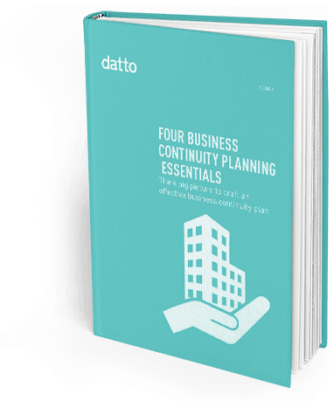
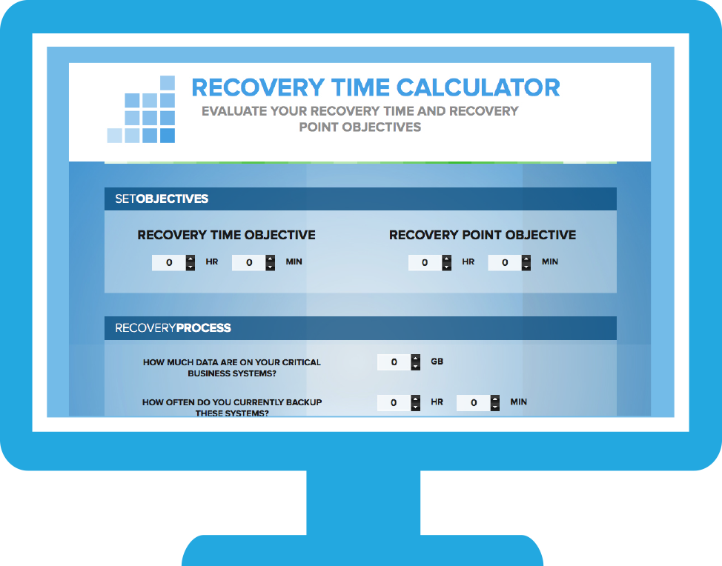
Learn more
Free RTO calculator:
datto.com/rto/
Check out our e-book:
4 Business Continuity
Planning Essentials

